Slide 1

EDGE-BASED V2X EFFICIENT TRAFFIC EMERGENCY RESPONDING PROTOCOL (TASK SCHEDULING)
CONFERENCE: DIVANET '21
NOVEMBER 22–26, 2021, ALICANTE, SPAIN
GROUP 12 - POWERRANGERS
AARON AYUB
DEPARTMENT OF CS
BROCK UNIVERSITY
THIAGO S. GOMIDES
DEPARTMENT OF CS
BROCK UNIVERSITY
ROBSON E. DE GRANDE DEPARTMENT OF CS
BROCK UNIVERSITY
1
Notes:
Good morning, everyone. We are Group 12, also known as the Power Rangers. Today, I'll be introducing our project: an 'Edge-Based V2X Efficient Traffic Emergency Responding Protocol,' with a focus on task scheduling.

Slide 2
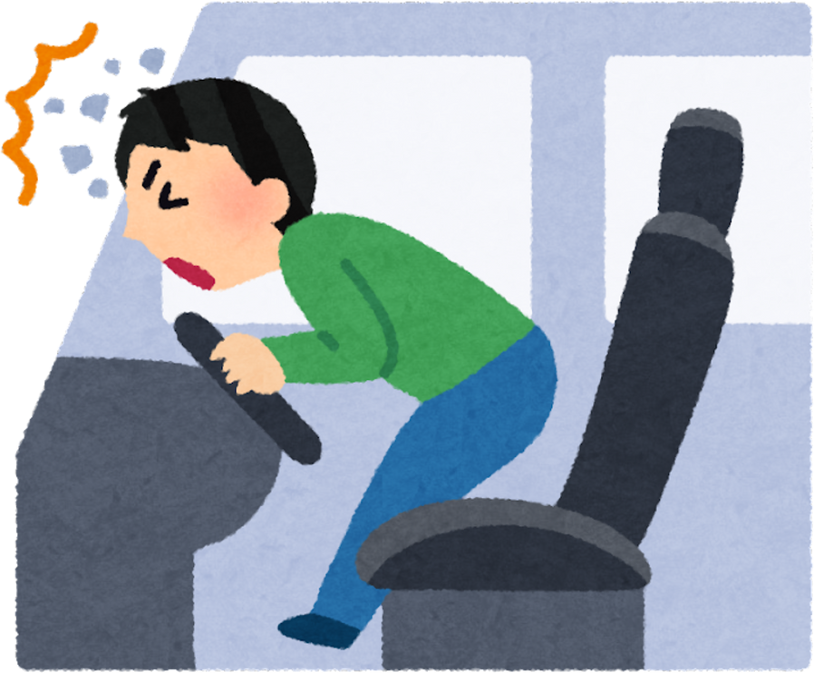
UNDERSTANDING THE PROBLEM STATEMENT
“When accidents happen on the road, emergency vehicles often get delayed — this project solves that by quickly finding and guiding the nearest rescue vehicle using smart road-side edge devices.”
2
Notes:
"So, what is the problem we are solving? When accidents happen on the road, emergency vehicles are often delayed. Our project directly tackles this issue. We aim to create a system that uses smart roadside devices to rapidly find and guide the nearest emergency vehicle to an accident scene."

Slide 3
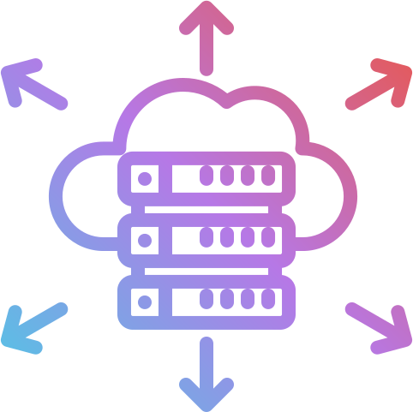
WHY EDGE ?
EDGE NODES = PROXIMITY = REDUCED LATENCY
REAL-TIME AWARENESS OF ACCIDENT ZONES VIA EDGE DATA COLLECTION AND FASTER RESPONSE
IDEAL FOR DECENTRALIZED, DYNAMIC TRAFFIC ENVIRONMENTS , REDUCED CLOUD DEPENDENCY
3
Notes:
"Why have we chosen edge computing for our solution? There are three key reasons:
First, proximity equals reduced latency. Placing processing nodes at the 'edge' of the network, near the road, allows for much faster communication.
This leads to our second point: faster response times. By collecting data directly from the accident area, we get real-time awareness and can react instantly.
Finally, this approach is ideal for the dynamic nature of traffic because it
reduces our dependency on a centralized cloud, making the system more efficient and resilient."

Slide 4
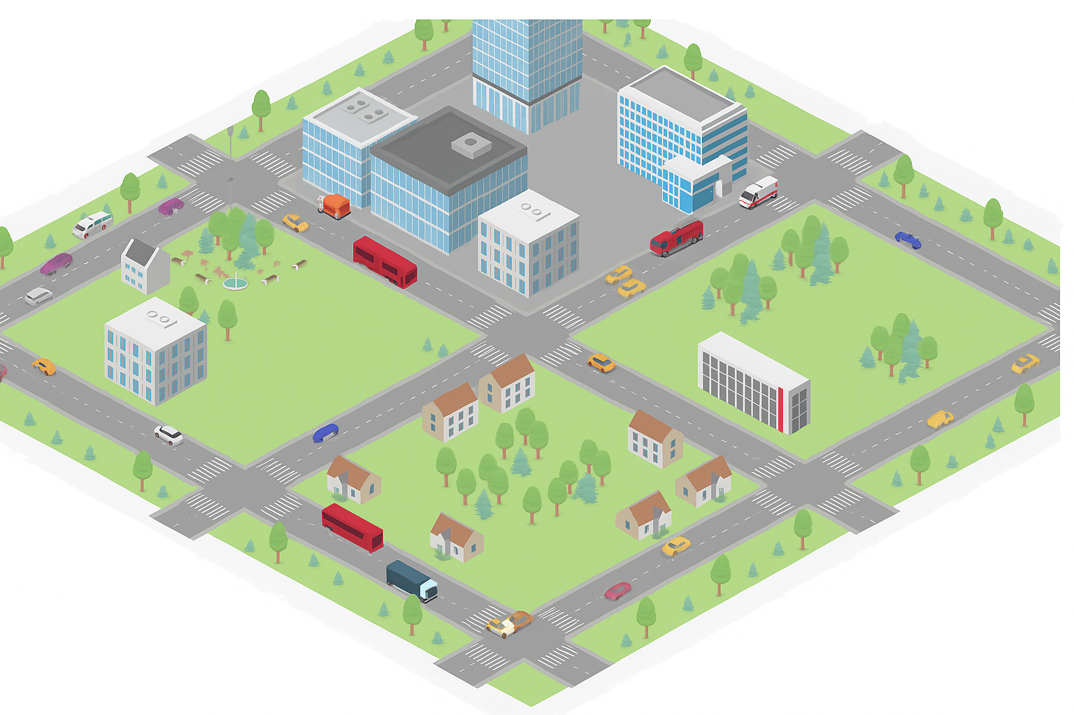


OVERVIEW
4

Slide 5



ALGORITHM
Accident Dissemination
ERV Discovery
ERV Selection
Route Dissemination
Resolution
Based on policy (e.g., shortest path)
ERV confirms; task marked complete
Vehicle detects and broadcasts alert
CEN queries ERVs
ERV shares route; other vehicles reroute
5

Slide 6
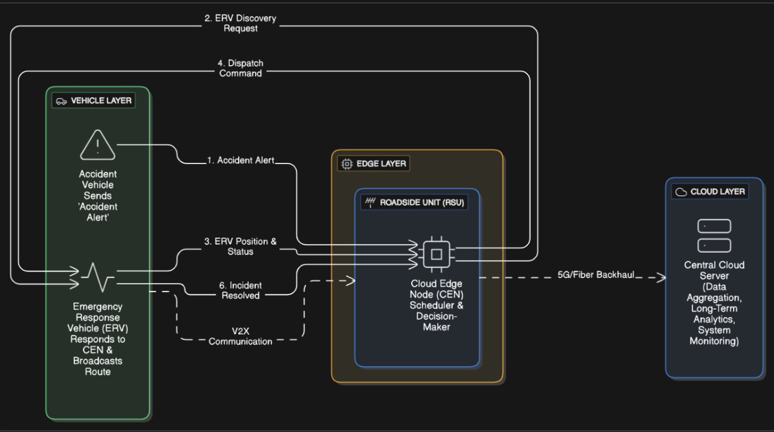
ARCHITECTURE
6

Slide 7
TASK SCHEDULING
WHY IT'S CRUCIAL
PREVENTS MULTIPLE ERVS FROM RESPONDING TO SAME ACCIDENT
SELECTS THE BEST-FIT ERV (FASTEST ROUTE, AVAILABILITY)
MAINTAINS ERV STATE (BUSY/FREE)
HOW IT'S DONE
CEN COLLECTS ERVS
APPLIES POLICY (SHORTEST/FASTEST PATH)
DISPATCHES BEST ERV
TRACKS STATE CHANGES (TASK START → TASK COMPLETE)
7

Slide 8

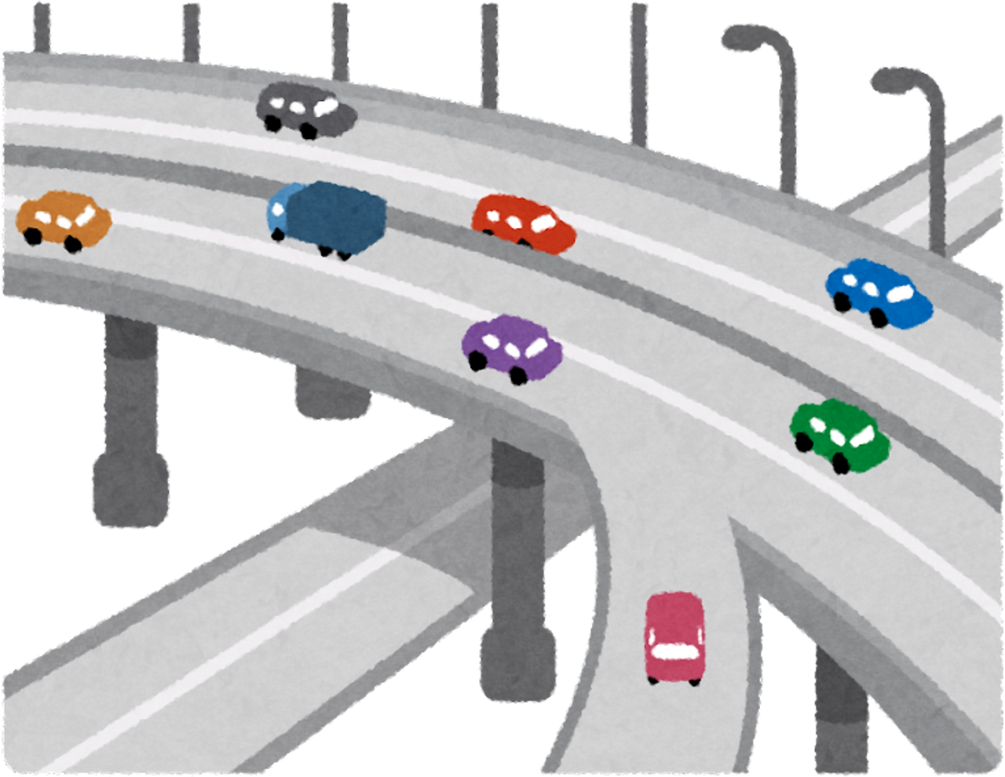
IMPLEMENTATION PLAN
Tools
SUMO (traffic)
OMNeT++ (network)
Veins (integration)
OpenStreetMap (real-world maps)
Modules to Build
Vehicle (regular + ERV)
CEN logic
V2X message simulation
Dynamic route updates
Visual logs and outputs
8
Notes:
🗣 "For our implementation, we use four main tools — SUMO for traffic simulation, OMNeT++ for networking, Veins to integrate both, and OpenStreetMap for realistic road layouts.
We’ll build five core modules: regular and emergency vehicles, the CEN logic for decision-making, V2X message simulation, dynamic route updates, and visual logs for outputs."

Slide 9
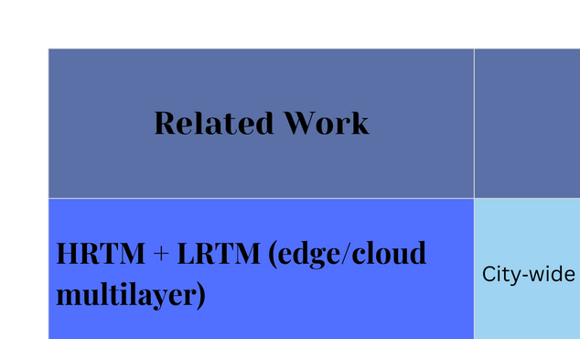
STATE-OF-THE-ART LITERATURE
Title: Managing Emergency Situations in VANET Through Heterogeneous Technologies Cooperation
Title: Emergency Message Dissemination in IoV Networks (EMD-IoV)
Title: SafeSmart: A VANET System for Faster Responses and Increased Safety in Time-Critical Scenarios
9
Notes:
HRTM + LRTM:
“Uses cloud and edge layers together. Cloud takes global decisions, edge handles local ones. But it's slower than our edge-only method.”
Clustering-based Messaging:
“Good for alert delivery, not for dispatching ERVs or clearing routes.”
SafeSmart (V2I + traffic lights):
“Changes traffic lights for ERVs, but needs smart infrastructure. Our system works without that.”

Slide 10
TASK SPLIT
Isha | Keerthi | Raghav | Akshar
Accident & Vehicle Logic | CEN Scheduling Logic | ERV Behavior & Coordination | Integration and Building
Implement Algorithm 1 (accident detection & dissemination) Code vehicle rerouting logic when ERV path is received Unit testing for vehicle-side behaviors | Implement Algorithm 2 (ERV discovery & selection) Code shortest/fastest path policy Manage accident tracking at edge node | Implement Algorithm 3 (ERV response, route broadcasting) Handle ERV-to-vehicle communication for lane clearing Implement ERV task completion messages | Build SUMO/OMNeT++/Veins scenario Integrate all three algorithms into simulation Implement visualization features (color change, message logs)
10

Slide 11
THANK YOU & Q/A
11

Slide 12
CITATIONS
HTTPS://WWW.MDPI.COM/290262
HTTPS://WWW.RESEARCHGATE.NET/PUBLICATION/350486240_VANET-BASED_TRAFFIC_MONITORING_AND_INCIDENT_DETECTION_SYSTEM_A_REVIEW?UTM_SOURCE=CHATGPT.COM
HTTPS://WWW.RESEARCHGATE.NET/PUBLICATION/269327220_IMPACT_OF_VANET-BASED_TRAFFIC_SIGNAL_CONTROL_ON_THE_RESPONSE_TIME_OF_EMERGENCY_VEHICLES_IN_REALISTIC_LARGE_SCALE_URBAN_AREA?UTM_SOURCE=CHATGPT.COM
12

